Slide 1
WEB DESIGNING AT ARICENT
Industrial Internship
16BCE0944
Akshay Arora

Slide 2

About Aricent
Aricent is a global design and engineering company innovating for customers in the digital era.
They help their clients lead into the future by solving their most complex and mission critical issues through customized solutions.
They are the expertise behind many of the technologies that are powering a fully connected world.

Slide 3
Some Services Aricent Provides
Digital Design Services
Software Product Development
Systems and Silicon Development
Testing Services
Product Sustenance and Maintenance

Slide 4
PREVIOUS ACQUIRED KNOWLEDGE
BASIC HTML
Before joining the company for a month-long internship, I only knew about basic HTML on how to make a simple webpage. I knew nothing about styling using CSS etc or any JavaScript techniques. I was able to design just a basic webpage using simple tags like <p>, <body>, <h1> to <h6>, <title>, <table> etc.

Slide 5
SQL
I also knew about database management using SQL language. All the basic commands and how to create, edit and delete contents in a database. All these commands were taught in the curriculum in the previous semester in database management systems (DBMS).
SQL is a programming language for Relational Databases. It is designed over relational algebra and tuple relational calculus. SQL comes as a package with all major distributions of RDBMS.

Slide 6
BASIC ANDROID APP DEVELOPMENT
I had a knowledge about basic android app development on how to create various pages (known as activities), buttons and taking input from using and manipulating them accordingly which I got from various courses like Google Developers Group for which I had to make a weather app as a final project for the course.
Also, I had designed some basic apps in my school time for competitions etc. I had also used these app development techniques for making an app in the course- Theory of Computation (TOC).

Slide 7
CODING LANGUAGES
I also knew a few coding languages like C, C++, Python etc but the most important language in the industry is python. I had learnt python in the first semester which was very useful as a base in understanding various other coding languages.

Slide 8
PHOTOSHOP
Knowledge of photoshop is very helpful in any designing industry especially web designing.
It helped me design logos, icons and backgrounds to make website look aesthetically appealing.
It can also help in making a basic website design as a template before starting it to actually design it.

Slide 9
KNOWLEDGE ACQUIRED
Advanced HTML
Some of the techniques I learnt while studying advanced HTML are-
Non-breaking spaces
Special characters
Floating Frames
Meta Tags

Slide 10
Style Sheets
A Style Sheet is a collection of style rules that that tells a browser how the various styles are to be applied to the HTML tags to present the document.
Style Sheets can be external or internal to your Web site and/or external or internal to your Web pages.
Types-
CSS
SASS
SCSS
LESS

Slide 11
SCRUM
Scrum is an agile way to manage project, usually software development. Agile software development with scrum is often perceived as a methodology, but rather than viewing scrum as methodology, think to it as a framework for managing a process.
In scrum, on each day of a sprint, the team holds a daily scrum meeting called the "daily scrum.” Meetings are typically held in the same location and at the same time each day.

Slide 13
JavaScript
JavaScript enables interactive web pages and thus is an essential part of web applications. The vast majority of websites use it, and all major web browsers have a dedicated JavaScript engine to execute it.
It has an API for working with text, arrays, dates, regular expressions, and basic manipulation of the DOM

Slide 14
Bootstrap
Bootstrap is a free and open-source framework used for designing websites and web applications. It contains HTML- and CSS-based design templates for typography, forms, buttons, navigation and other interface components.
Bootstrap is modular and consists of a series of Less stylesheets that implement the various components of the toolkit.

Slide 15
Angular
Angular is a platform that makes it easy to build applications with the web.
Angular combines declarative templates, dependency injection, end to end tooling, and integrated best practices to solve development challenges.
It is a TypeScript-based open-source front-end web application platform led by the Angular Team at Google and by a community of individuals and corporations. Angular is a complete rewrite from the same team that built AngularJS.

Slide 16
Components
Every Angular application has at least one component, the root component that connects a component hierarchy with the page document object model (DOM).
Each component defines a class that contains application data and logic, and is associated with an HTML template that defines a view to be displayed in a target environment.

Slide 17
Routing
The Angular Router NgModule provides a service that lets you define a navigation path among the different application states and view hierarchies in your app.
It is modelled on the familiar browser navigation conventions
The router maps URL-like paths to views instead of pages. When a user performs an action, such as clicking a link, that would load a new page in the browser, the router intercepts the browser's behaviour, and shows or hides view hierarchies.

Slide 18
Google Map Integration
Angular Google Maps is a set of directives that integrate Google Maps in an AngularJS application.
It makes using Google Maps in such an application very easy as you don’t need to know the Google Maps API in order to use it.
Google Maps allows you to attach events to your map, your markers, and basically anything you add to your map.

Slide 19
Basic Map Types
The following map types are available in the Maps JavaScript API:
roadmap displays the default road map view.
satellite displays Google Earth satellite images.
hybrid displays a mixture of normal and satellite views.
terrain displays a physical map based on terrain information.

Slide 20
Application in Training
Startup Website Homepage
I had to design a homepage for a startup company which looks visually appealing and original to the idea.
So, I created a startup that is basically an on-call valet services for people which can be called through an app or a website to help people park their cars.

Slide 21
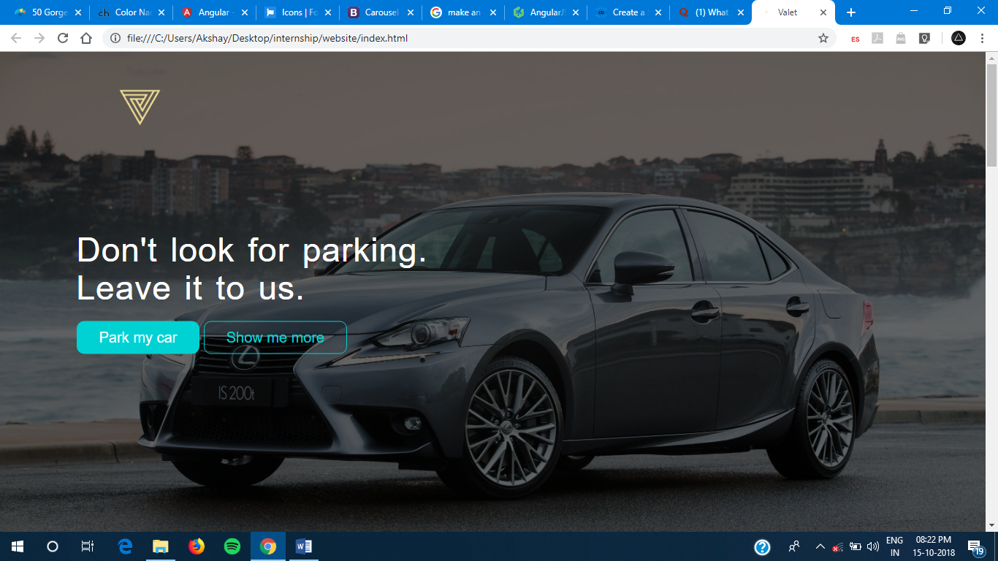

Slide 22
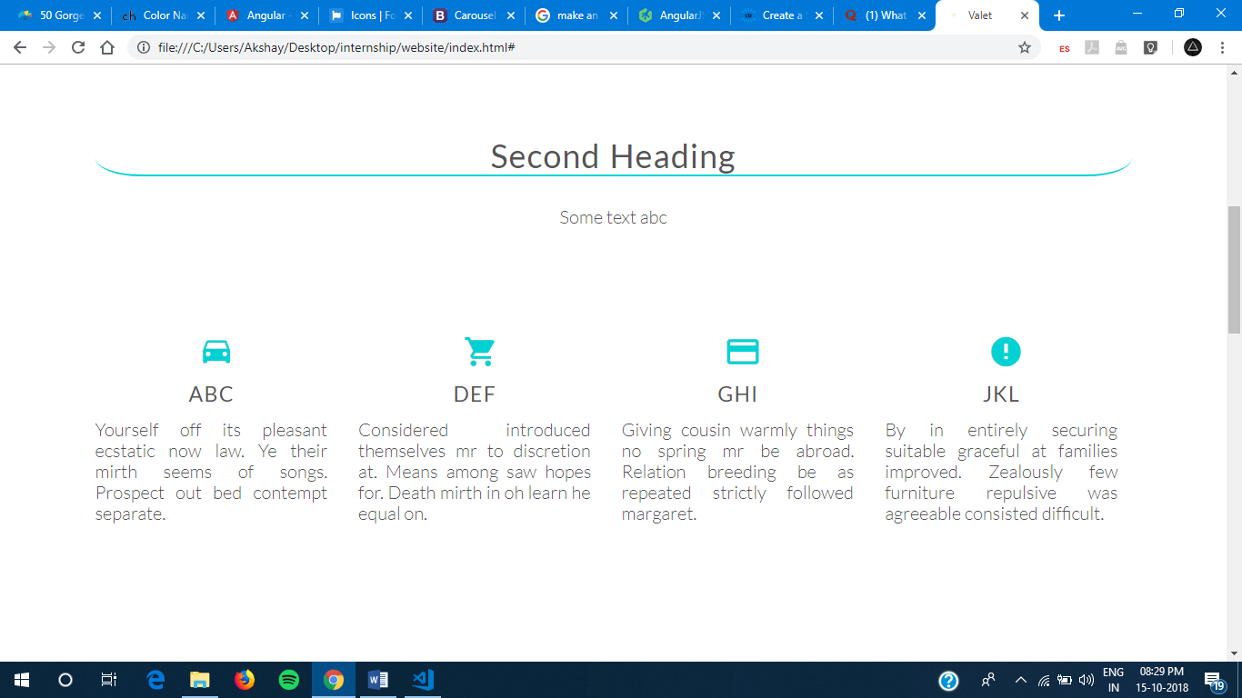

Slide 23
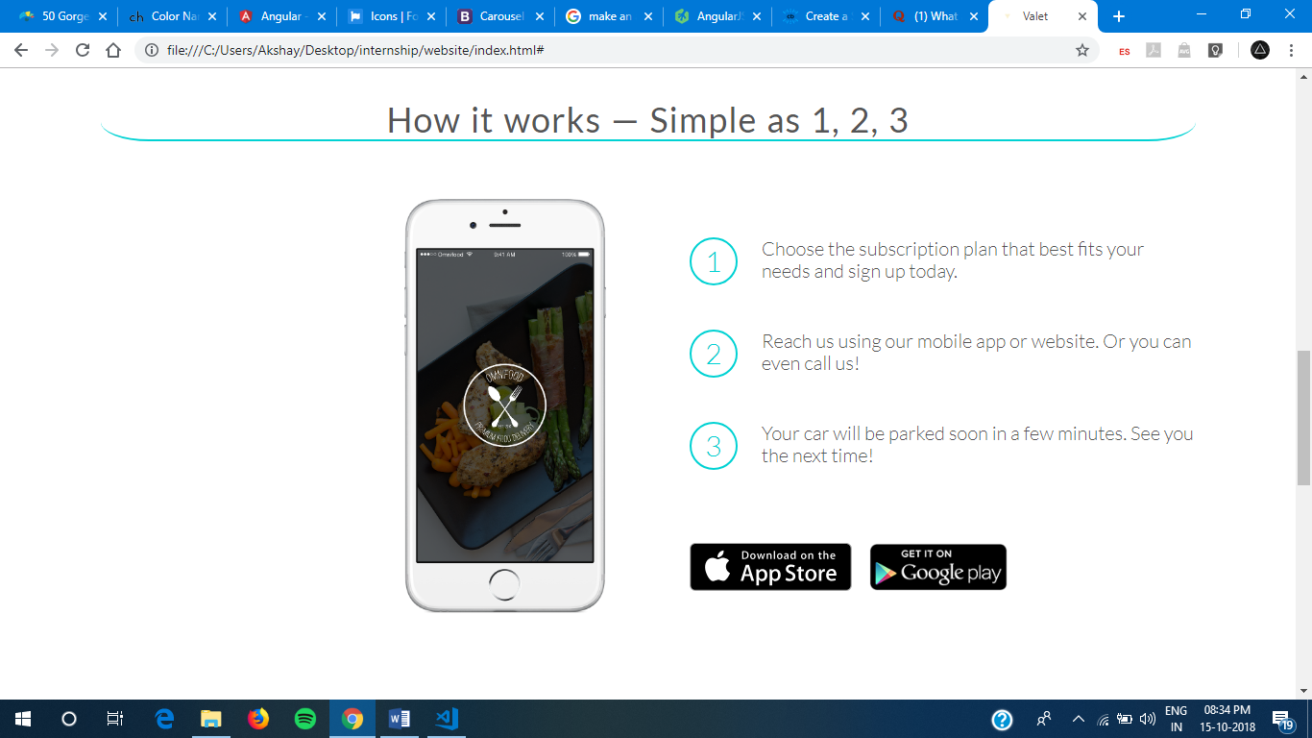

Slide 24
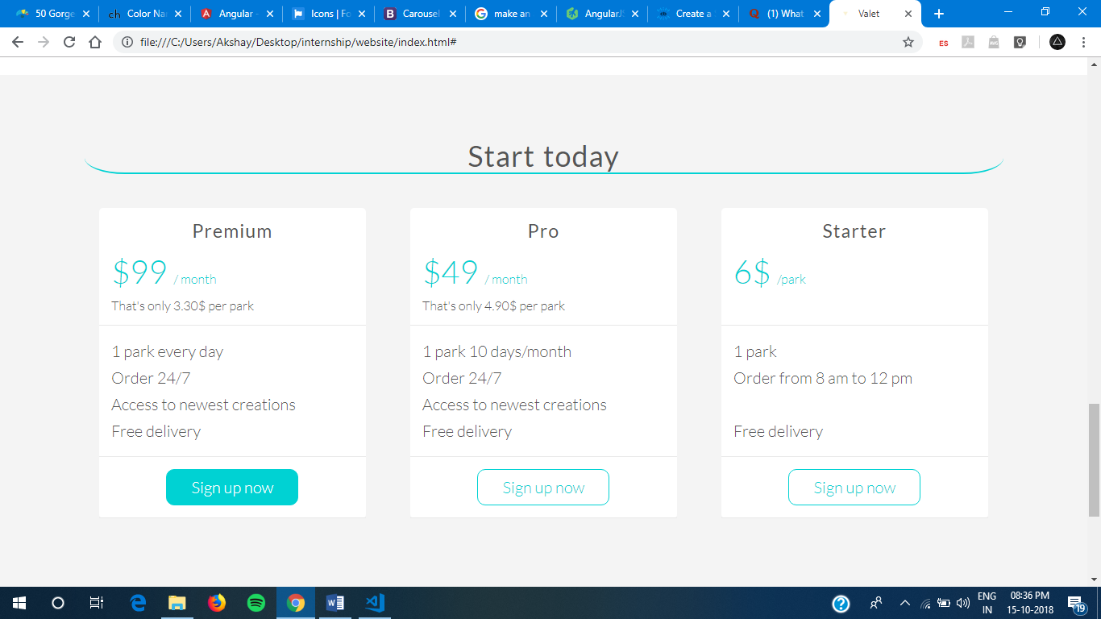

Slide 25
Google Map Integration Using Angular
I started to learn about google-map integration using angular because of a project my assigned department was working on.
I tried to implement this map in the webpage using angular along with different layers and an array which can be searched through using a search bar.
I even used reusable components and did routing to send data from one component to another.

Slide 26
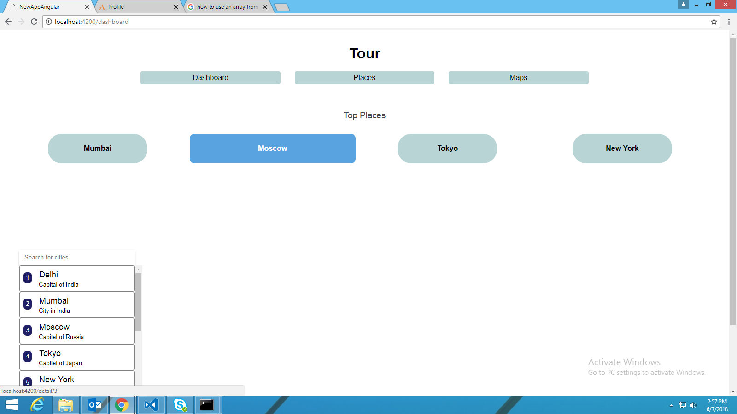

Slide 27
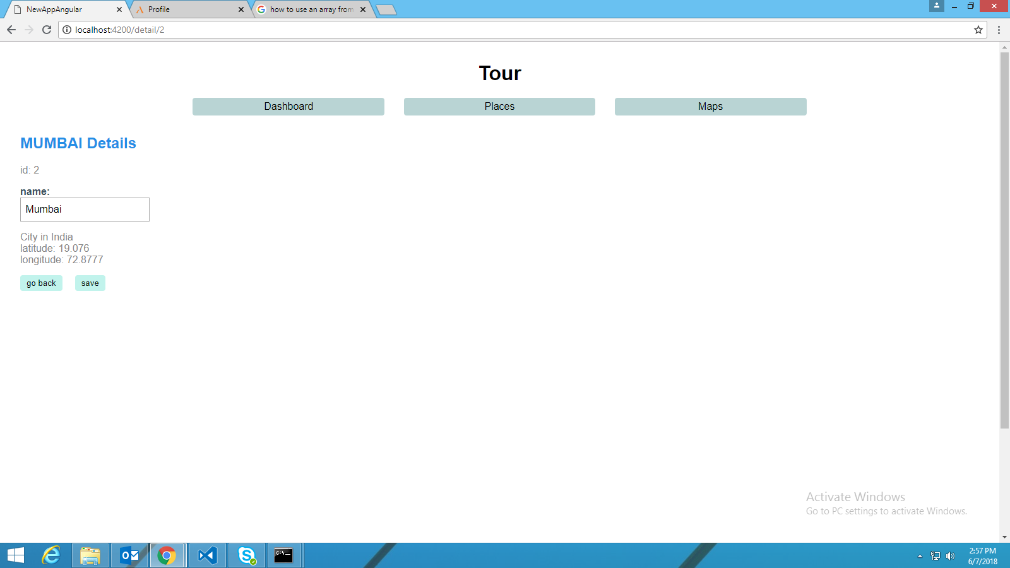

Slide 28
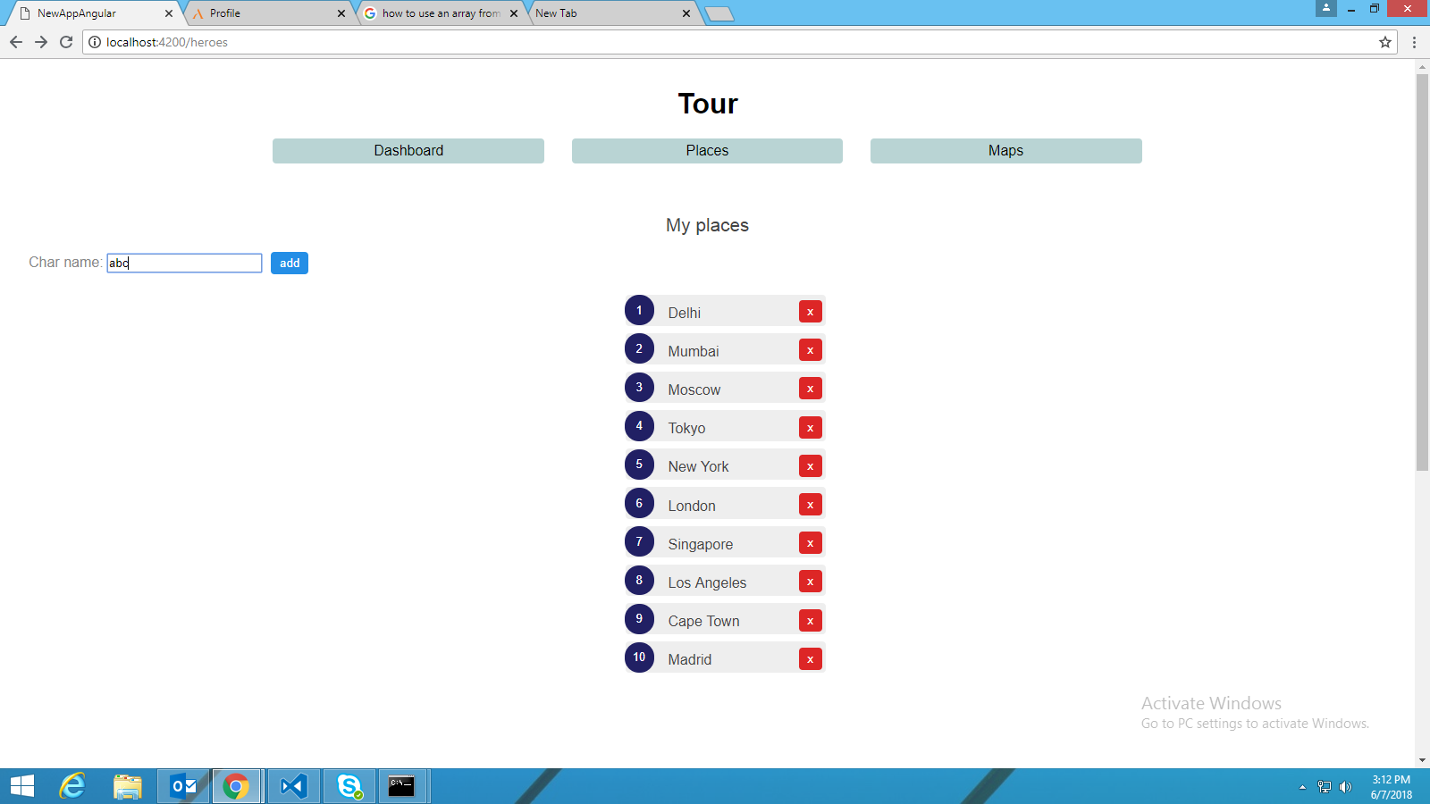

Slide 29
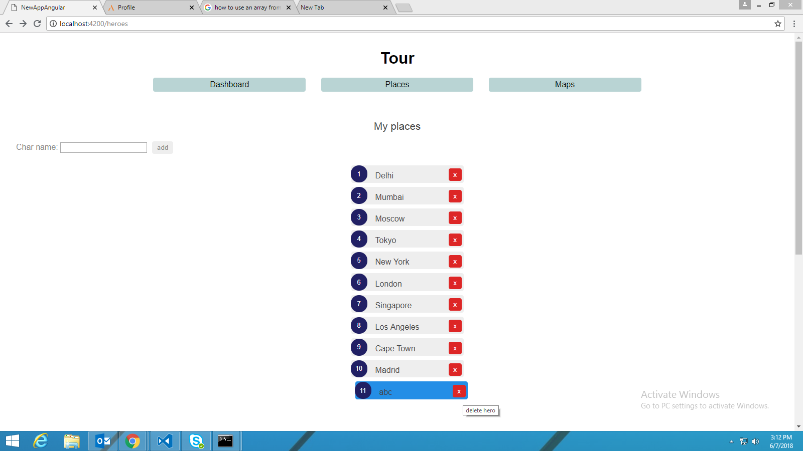

Slide 30
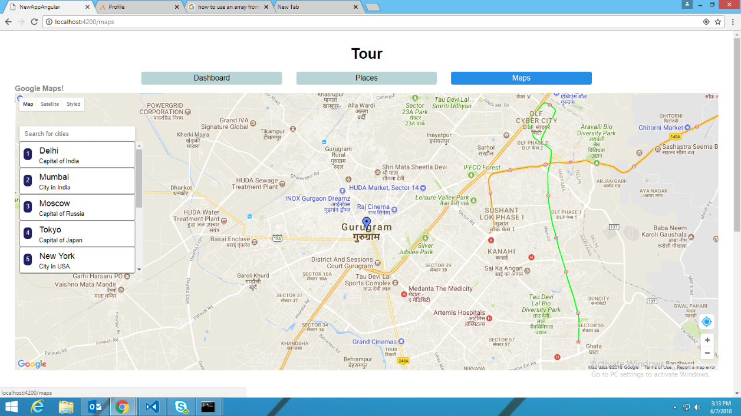

Slide 31
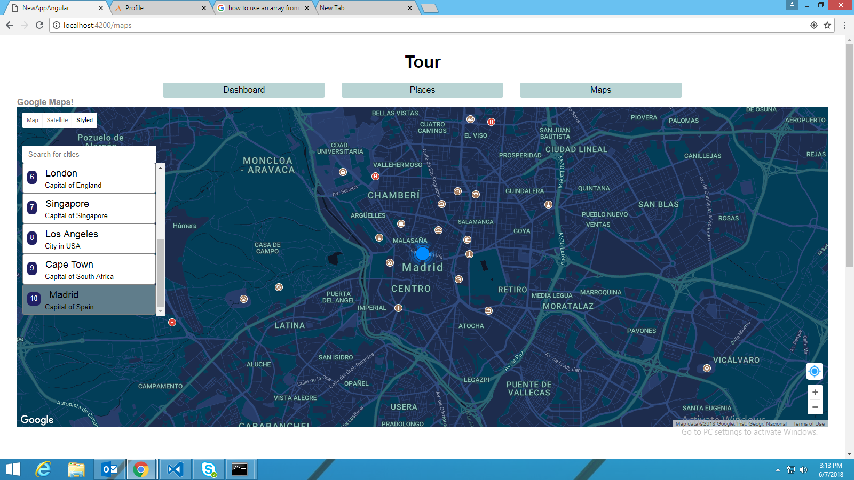

Slide 32
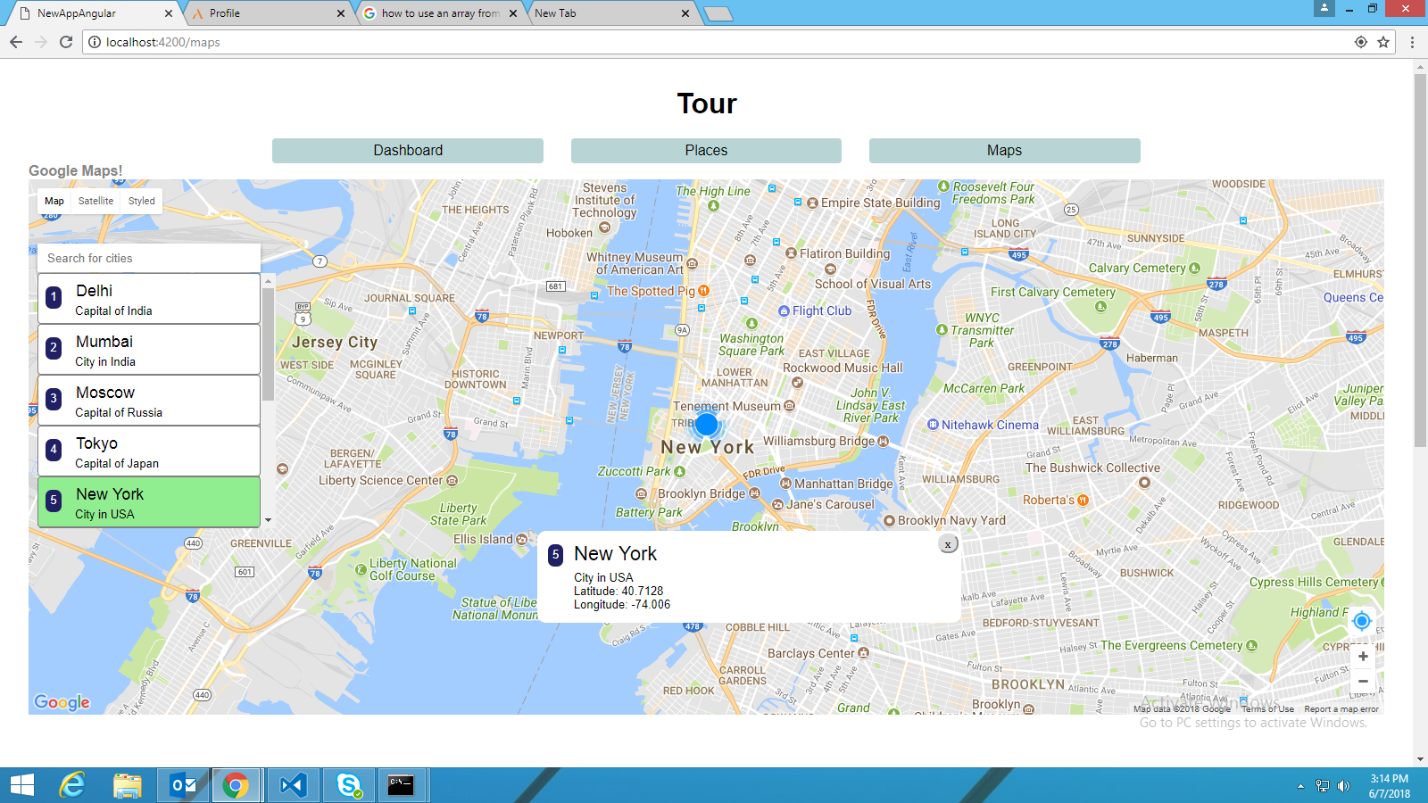

Slide 33
Conclusion
This Internship in Aricent was a great experience for me.
It opens up many new opportunities for me to have career in this field.
I learned to work faster and efficiently.
It provided an opportunity to explore career opportunities with potential “full-time” employers, learn new skills, gain work experience.

Slide 34
THANK YOU

